Slide 1

Elkins High School Junior Presentations

Slide 2

Graduation is not that far away!
My transcript – in Skyward Portfolio
Rank Letters – in Skyward Portfolio
What are the graduation requirements? You can check your Grad Reqs in Skyward
What is my graduation plan?
How many credits do I have?
Am I on track – do I need to recover credits?
Did I meet my EOC requirements?
How do I look to a college based on my transcript?

Slide 3
Attendance counts!
Remember you can lose credit if you are absent 8 or more times – even if you have a passing grade!
If you need to make up hours due to attendance, be sure to do it. You want to start Senior year in a good position and not have to worry about recovering credits lost because of attendance.

Slide 4
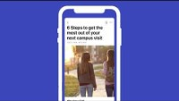
PSAT/NMSQT
What to Expect
Notes:
Script template:​
Students preparing for the digital PSAT/NMSQT will have access to free, high-quality test preparation resources. Watch this video to learn more.

Slide 5
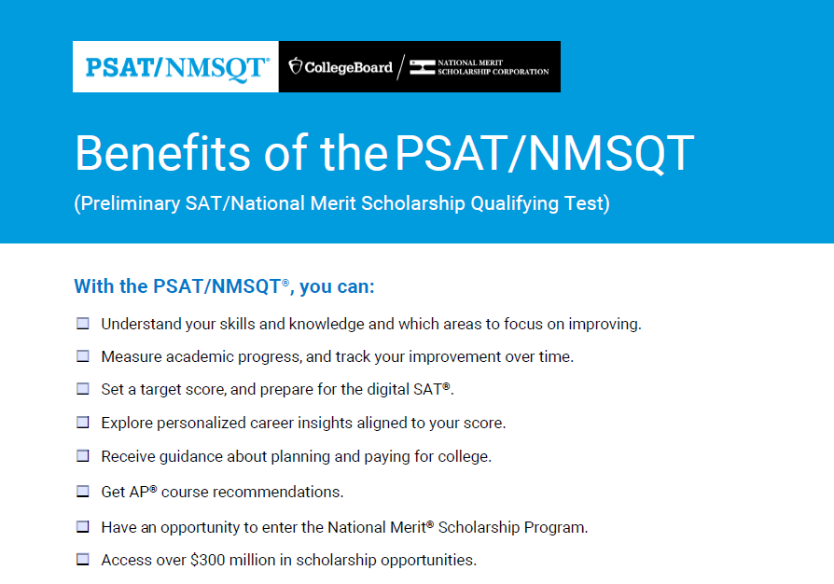

Slide 6
SAT/ACT
Which test should I take? BOTH – decide which one you are more comfortable with or do better on and stay with that one.
SAT School Day – ALL juniors will automatically be registered for a FREE SAT test on campus in the spring and then sign up for another SAT/ACT in May/June.
When should I test again? The spring tests after you SAT School Day – May & June.

Slide 7
Other things to think about.....
Do I hope to play Division I or II sports? Be sure to complete the NCAA Clearinghouse: https://web3.ncaa.org/ecwr3/
What are my options for summer? Take a dual credit course or other summer course, do an internship or a summer program
Colleges look at your 6 semester transcript – this includes any high school credits earned in middle school and grades 9-11, so do well this year and be sure to finish strong.
Don’t have any idea about after high school?? Sign up for the ASVAB 11/12 at EHS – it will show you your strengths and which careers would be a good fit!

Slide 8
What can I do to make colleges say WOW?
Make your grades top priority
Seek opportunities to get involved – build your resume, take on leadership roles
Build relationships with decision makers at the college, counselors and teachers.
Attend College Fairs and visit with College reps on our campus
Research and visit prospective colleges

Slide 9

Logging into Schoolinks
1Link
Clever
Schoolinks

Slide 10

Self-Assessment
Look for To Do List on top tool bar where it says, “To Do List”.
Click on Show Remaining To Do’s – this will pull up your assessments. You will:
  Click on Create SMART Goals and add your SMART Goal about PSAT. Once you add your goal, mark as complete.
  2. Complete Social Emotional Learning Assessment and mark as complete when done.
  3. Needs Assessment – if you have not done so already, please do this also.

Slide 11


